Slide 1
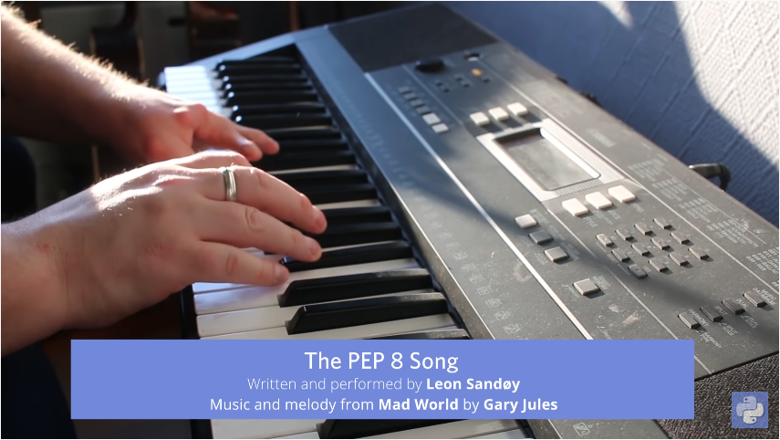
https://www.youtube.com/watch?v=hgI0p1zf31k

Slide 2



Slide 3
ESTRUCTURAS DE DATOS

Slide 4
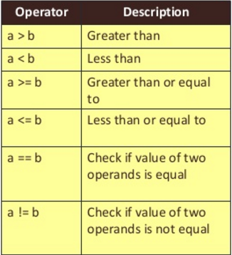
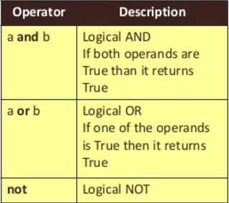
Logical operators

Slide 5
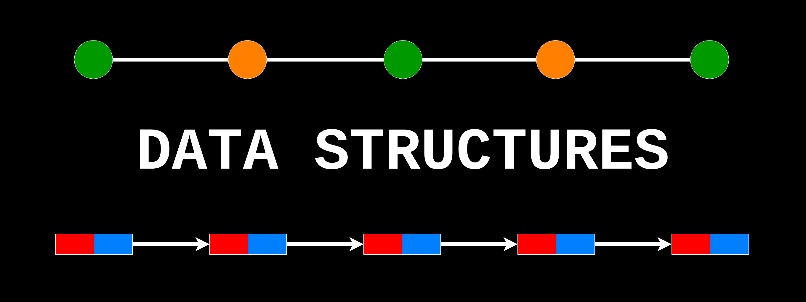

Slide 6

Lists, tuples and Dictionaries

Slide 7
Standard Data Types:
Python has 6 primitive (scalar) data types:
None
Boolean
Integer
Float
Complex
String
What is a structure?
A way of organizing one or more scalar types (none, boolean, integer, float, complex and string).

Slide 8
CPU
ROM
DATOS:
VELOCIDAD
VOLUMEN
VARIABILILDAD (estructuras)
HD
95% de los problemas
CÓDIGO:
ENTENDIBLE (documentación)
CORRECTO (testeo)
REUTILIZABLE (funciones, clases y paquetes)

Slide 9
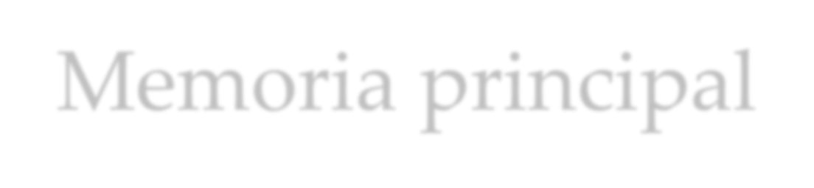

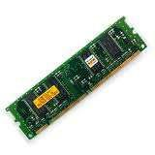
Memoria principal
Main memory en inglés.
Es donde se almacenas los programas mientras se están ejecutando.
También se almacenan los datos. (Von Newman)
RAM: Random Access Memory
o Memoria de acceso aleatorio
Se borra cuando se apaga el ordenador
Es muy rápida

Slide 10

Memoria principal
La memoria está dividida en pequeñas unidades llamadas bytes
Los bytes están formados por bits.
El bit podría definirse como la unidad mínima de
información.
A cada byte en la memoria se le asocia una dirección.

Slide 11
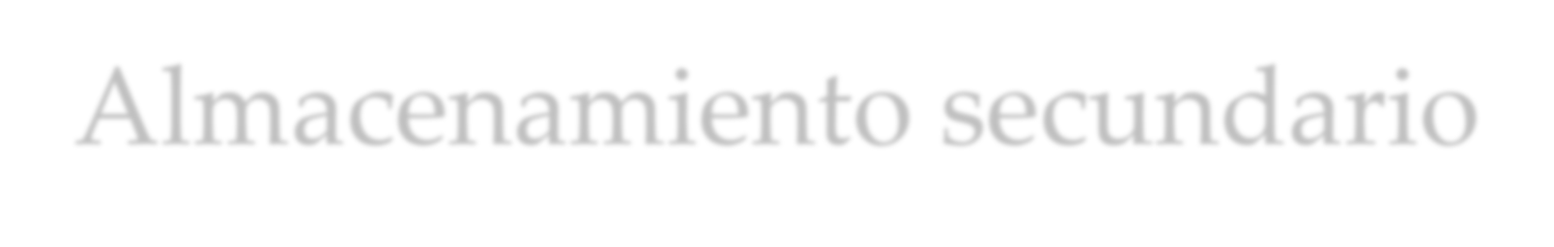
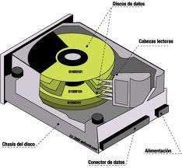
Almacenamiento secundario
Es un tipo de memoria que almacena datos durante mucho tiempo.
No se borran cuando se apaga el ordenador.
Es más lenta que la memoria principal
Frecuentemente, los programas son almacenados en la memoria secundaria y cargados en la memoria principal cuando es necesario.
Ej: Discos duros, SSD, etc.

Slide 12
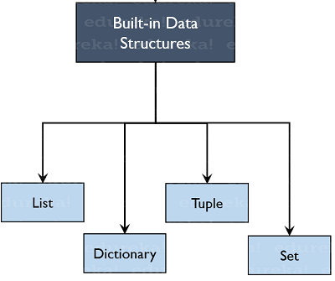
Built-in Data Structures:
Python has 4 standard data structures:
List
Tuple
Dictionary
Set
What is a structure?
A way of organizing one or more scalar types (none, boolean, integer, float, complex and string).

Slide 13
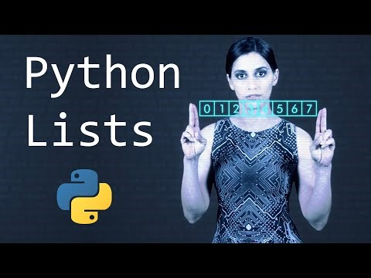

Slide 14
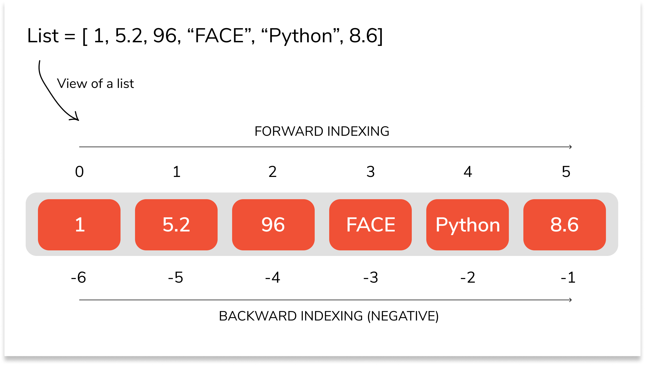
Python Lists:
Lists are the most versatile of Python's compound data types. A list contains items separated by commas and enclosed within square brackets ([]).
To some extent, lists are similar to lists in R. However lists are the default option in Python. All the items belonging to a list can be of different data type.
The values stored in a list can be accessed using the slice operator ( [ ] and [ : ] ) with indexes starting at 0 in the beginning of the list and working their way to end-1.
The plus ( + ) sign is the list concatenation operator, and the asterisk ( * ) is the repetition operator.

Slide 15
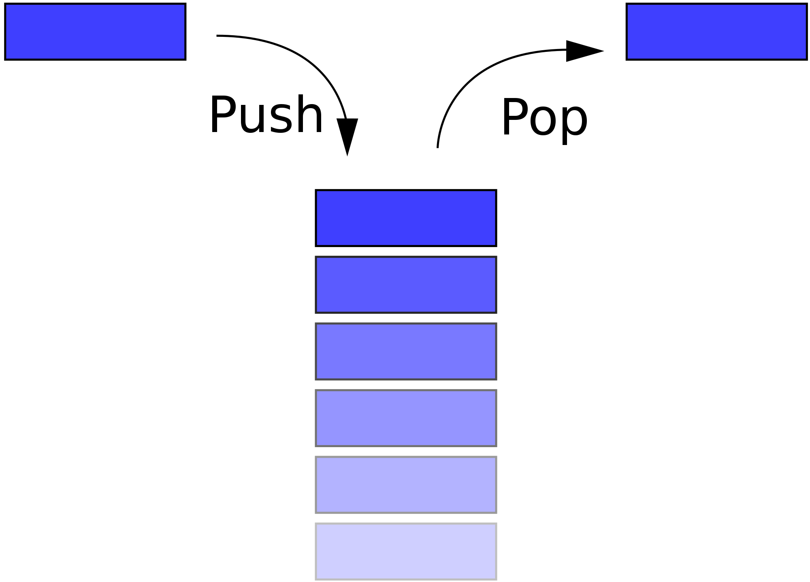
List as stack (Last In First Out)
append
pop
mylist = [ 'abcd', 786 , 2.23, 'john', 70.2 ]
mylist.append(10)
mylist.pop()

Slide 16
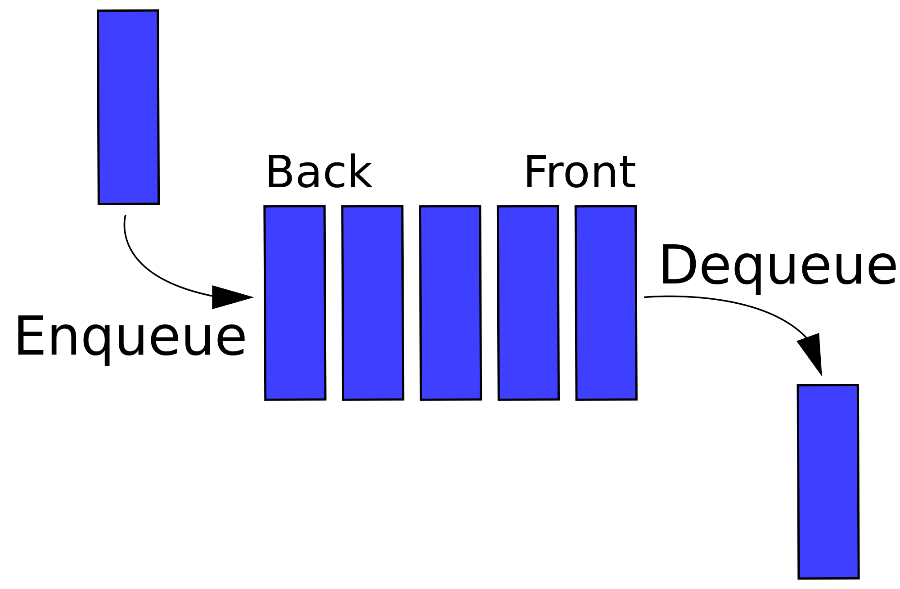
List as queue (First In First Out)
pop(0)
append
mylist = [ 'abcd', 786 , 2.23, 'john', 70.2 ]
mylist.append(10)
mylist.pop(0)

Slide 17
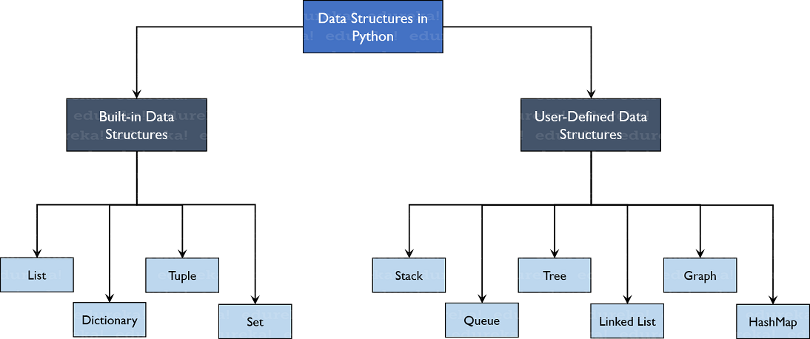

Slide 18
Escribir un programa en Python usando un loop for para sumar todos los elementos de la lista: mi_lista = [1, 2, 3, 4, 5]

Slide 19
Solución:
# Definir la lista de números
mi_lista = [1, 2, 3, 4, 5]
# Inicializar una variable para guardar la suma
suma = 0
# Recorrer cada elemento de la lista
for x in mi_lista:
# Sumar el elemento a la variable suma
suma += x
# Mostrar el resultado
print(suma)

Slide 20
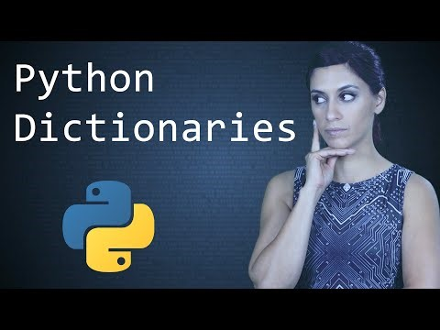

Slide 21
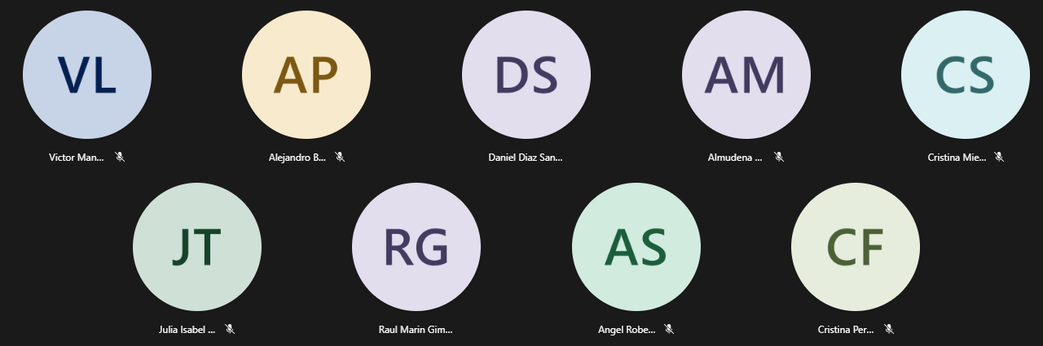

Slide 22
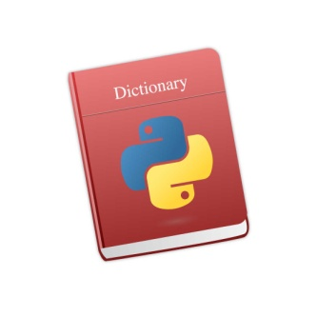
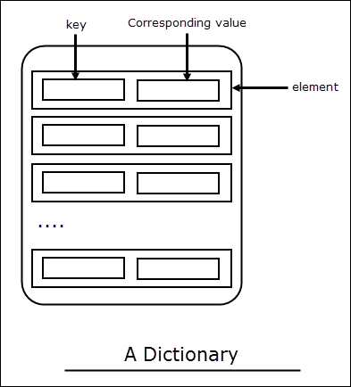
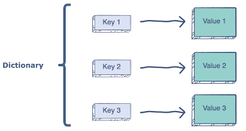

Python Dictionary:
Python 's dictionaries are hash table type. They work like associative arrays or hashes found in Perl and consist of key-value pairs.
Keys can be almost any Python type, but are usually numbers or strings. Values, on the other hand, can be any arbitrary Python object.
Dictionaries are enclosed by curly braces ( { } ) and values can be assigned and accessed using square braces ( [] ).

Slide 23

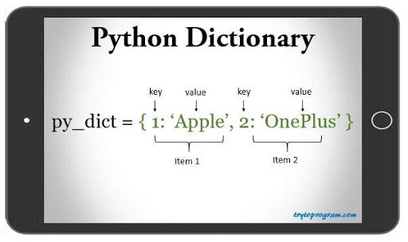
Python Dictionary - Syntax

Slide 24
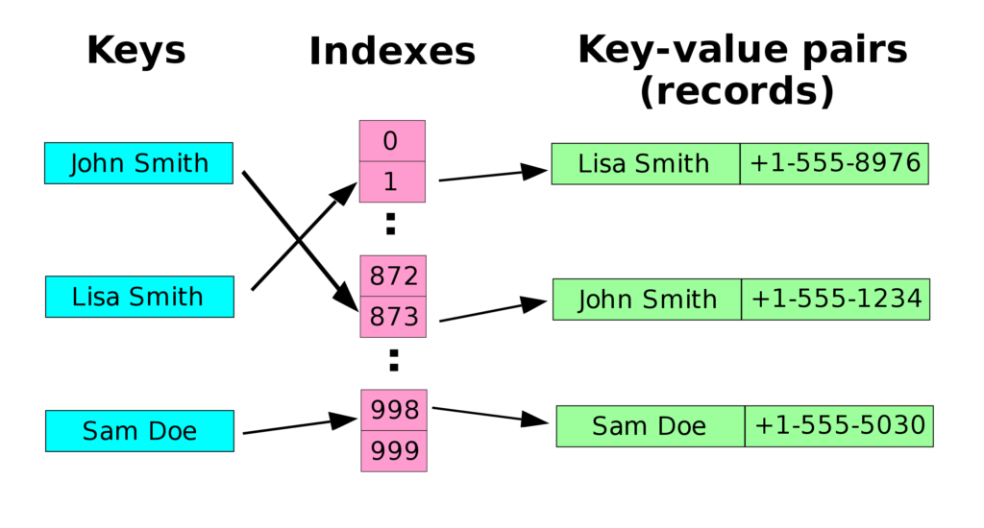
Python Dictionary – Is it efficient?
The fastest structure to find an element by key!

Slide 25

Which of the following statements are true?
a) Dictionaries do not have much value in Python b) Dictionaries are a fundamental part of Python c) Dictionaries are used extensively in applications d) Dictionaries are not at par with the tech innovation
Correct answer at 49:10
https://talkpython.fm/episodes/show/100/python-past-present-and-future-with-guido-van-rossum

Slide 26
Which of the following statements are true?
a) Dictionaries do not have much value in Python b) Dictionaries are a fundamental part of Python c) Dictionaries are used extensively in applications d) Dictionaries are not at par with the tech innovation
Correct answer: b and c at 49:10
https://talkpython.fm/episodes/show/100/python-past-present-and-future-with-guido-van-rossum

Slide 27
50%
Good / Appropriate Algorithm
30%
Good / Appropriate Data Structure
20%
Faster / +Memory Computer
By Prof. Manoel Gadi
Like Constants!
list
tuple
dictionary
set
COMMON:
Collection of 0, 1 or many of any combination of types of Python scalars
Pure Python (comes within the language)
DIFFERENTIAL:
Mutable, Ordered [0,n-1]
Immutable, Ordered [0,n-1]
Key is Unique and Unordered (key immutable / Value= Mutable)
Unique, Unordered
CREATE EMPTY:
list1=list(); list2=[]
tuple1=tuple(); tuple2=()
dict1=dict(); dict2={}
set1 = set()
CREATE:
list1 = [3,6,7,3,7]
tupple1 = (3,3,6,7,7)
dict1 ={3:'str',6:False}
set1 = {3,6,7}
INSERT:
list1.append(8)
-
dict1['Juan'] = 'Casado'
set1.add(8)
INSERT IN POSITION:
list1.insert(3,'value')
-
-
-
list1.pop(1) / list1.remove(3)
REMOVE:
-
del dict1['Juan']
set1.remove(8)
Python Ecosystem (libraries)
Data frame (pandas)
Key-Value (pickledb)
HDFS (pytables)
SQL

Slide 28
Python Basic Exercises 5 - Lists
(home work: will be solved next class)
Write a program which accepts a sequence of comma-separated numbers from console and generate a list and a tuple with the square of every number.
Suppose the following input is supplied to the program: 34,67,55,33,12,98
Then, the output should be:
[1156, 4489, 3025, 1089, 144, 9604]
(1156, 4489, 3025, 1089, 144, 9604)
Hint: In case of input data being supplied to the question, it should be assumed to be a console input. tuple() constructor method can convert list to tuple

Slide 29
Python Basic Exercises 5 - Lists
(home work: will be solved next class)
Write a program which accepts a sequence of comma-separated numbers from console and generate a list and a tuple with the square of every number.
SOLUTION:
numbers_str = input("Please enter a comma-separated sequence of numbers:")
numbers_list = numbers_str.split(",")
numbers_squared_list = []
for item in numbers_list:
numbers_squared_list.append(float(item)**2)
numbers_squared_tuple = tuple(numbers_squared_list)
print(numbers_squared_list)
print(numbers_squared_tuple)

Slide 30
Python Basic Exercises 6 - Dictionary
(home work: will be solved next class)
With a given integer number n, write a program to generate a dictionary that contains (i, i*i) such that is an integral number between 1 and n (both included). Finally, the program should print the dictionary.
Suppose the following input is supplied to the program: 8 Then, the output should be:
{1: 1, 2: 4, 3: 9, 4: 16, 5: 25, 6: 36, 7: 49, 8: 64}
Hint: In case of input data being supplied to the question, it should be assumed to be a console input. Consider using the constructor method dict()

Slide 31
Python Basic Exercises 6 - Dictionary
(home work: will be solved next class)
With a given integer number n, write a program to generate a dictionary that contains (i, i*i) such that is an integral number between 1 and n (both included). Finally, the program should print the dictionary.
SOLUTION:
n = int(input("Please enter a positive integer number: "))
n_dict = {}
for i in range(n):
n_dict[i] = i**2
print(n_dict)

Slide 32
list: delete items from the end of a list called myList: myList.pop() dictionary: delete a key-value pair from the high_lows dictionary: del high_lows[key]
set: delete an item from a set: myset.remove(item)
Example: # language set language = {'English', 'French', 'German'}
# removing 'German' from language language.remove('German')
# Updated language set print('Updated language set:', language)
About del high_lows[key] del something # (1) It is procedural programming
del(something) # (2) It is functional programming
something.del() # (3) It is object oriented programming
3 different paradigms, and Python is 80% (3), 19% (2) and some bizarre occasitions it is (1) like in del high_lows[key]!!!
Normally (3) means that the function is specific to the object therefore called method, (2) means that a function can be applied to more than one type of object and (1) it means that Python has to call low level operations to do the trick.

Slide 34
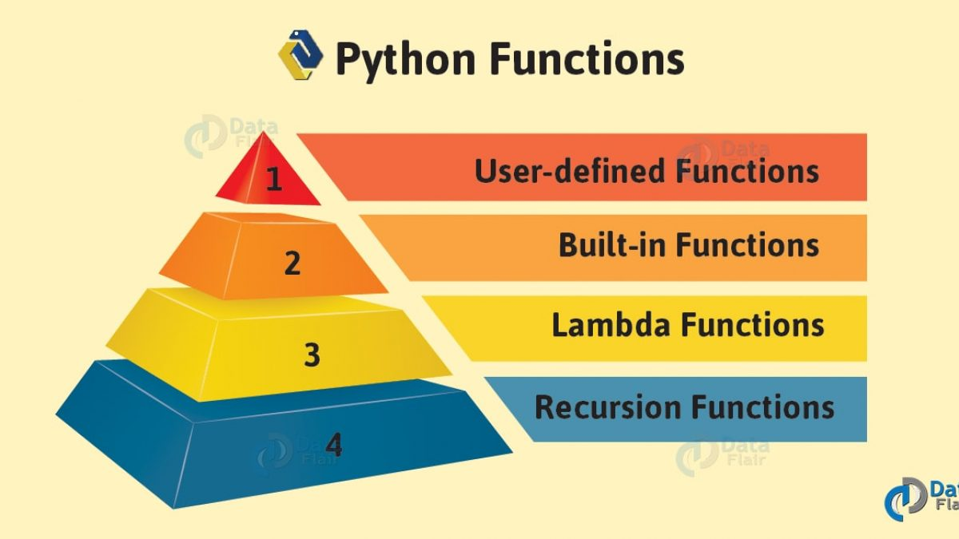
Functions
a named section of a program that performs a specific task

Slide 35
Functions:
A way of organizing code to make it more understandable, easy to use, reproducible and easier to share.

Slide 36
CPU
ROM
DATOS:
VELOCIDAD
VOLUMEN
VARIABILILDAD (estructuras)
HD
95% de los problemas
CÓDIGO:
ENTENDIBLE (documentación)
CORRECTO (testeo)
REUTILIZABLE (funciones, clases y paquetes)

Slide 37
list: delete items from the end of a list called myList: myList.pop() dictionary: delete a key-value pair from the high_lows dictionary: del high_lows[key]
set: delete a item from a set: myset.remove(item)
Example: # language set language = {'English', 'French', 'German'}
# removing 'German' from language language.remove('German')
# Updated language set print('Updated language set:', language)
About del high_lows[key] del something # (1) It is procedural programming (PP)
del(something) # (2) It is functional programming (FP)
something.del() # (3) It is object oriented programming (OOP)
3 different paradigms, and Python is 80% (3 - OOP), 19% (2 - FP) and some bizarre cases it is (1 - PP) like in del high_lows[key]!!!
Normally (3) means that the function is specific to the object therefore called method, (2) means that a function can be applied to more than one type of object and (1) it means that Python has to call low level operations to do the trick.

Slide 38
functions vs. methods
A function looks like this: function(something)
And a method looks like this: something.method()
>>> a = ' BiG MuG '
>>> a.lower()
' big mug '
>>> a.upper()
' BIG MUG '
>>> a.strip()
'BiG MuG'
>>> a.strip().upper()
'BIG MUG'
>>> a.strip().upper().split(' ')
['BIG', 'MUG']
>>> ';'.join(a.strip().upper().split(' '))
'BIG;MUG’
A function can be applied to one or more type of things (objects), while methods are specific and can only be applied to “things” (objects) of one given type (one given class)

Slide 39
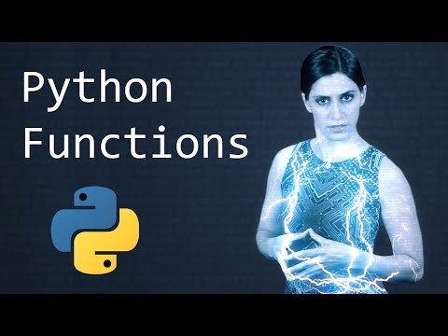
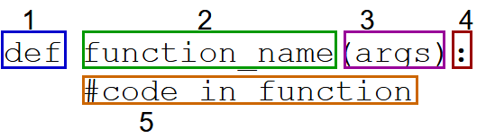
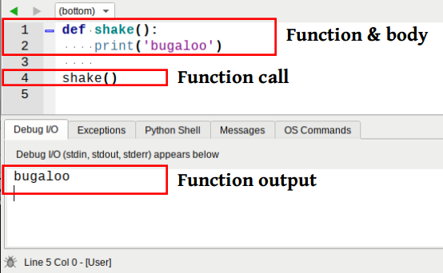
User defined functions

Slide 40
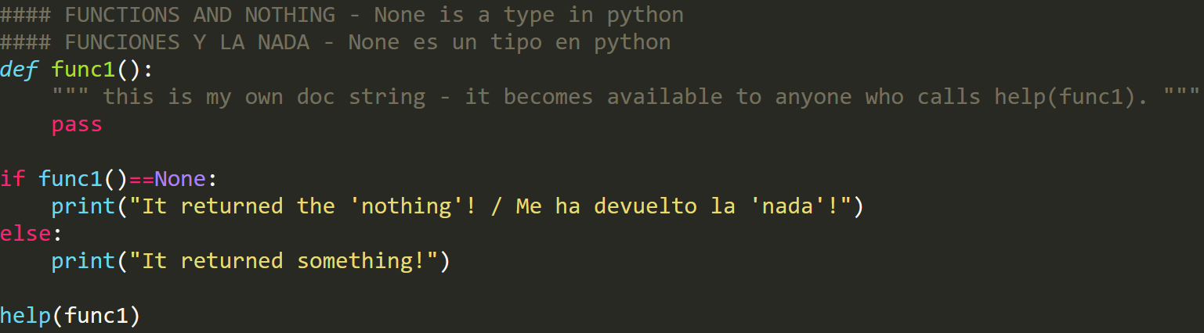
#### FUNCTIONS AND NOTHING - None is a type in python
#### FUNCIONES Y LA NADA - None es un tipo en python
def func1():
""" This is my own doc string - it becomes available to anyone who calls help(func1)."""
pass
if func1()==None:
print("It returned the 'nothing'! / Me ha devuelto la 'nada'!")
else:
print("It returned something!")
help(func1)

Slide 41
Numeric Strings Constructors Iterables (Lists, Dicts,…) |  | Built-in Functions |  | Python Functioning Iinput / Output
abs() – Numeric | delattr() | hash() | memoryview() | set() - Constructors
all() | dict() - Constructors | help() | min() - Numeric | setattr()
any() | dir() | hex() - Constructors | next() | slice()
ascii() | divmod() | id() | object() | sorted()
bin() | enumerate() | input() - Iinput / Output | oct() | staticmethod()
bool() - Constructors | eval() - Python Functioning | int() | open() - Iinput / Output | str()
breakpoint() | exec() | isinstance() | ord() | sum()
bytearray() | filter() | issubclass() | pow() | super()
bytes() - Constructors | float() | iter() | print() - Iinput / Output | tuple()
callable() | format() - Strings | len() | property() | type()
chr() - Strings | frozenset() | list() - Constructors | range() - Iterables | vars()
classmethod() | getattr() | locals() | repr() | zip()
compile() - Python Functioning | globals() | map() | reversed() - Strings | __import__()
complex() - Constructors | hasattr() | max() -Numeric | round()
https://docs.python.org/3/library/functions.html

Slide 42
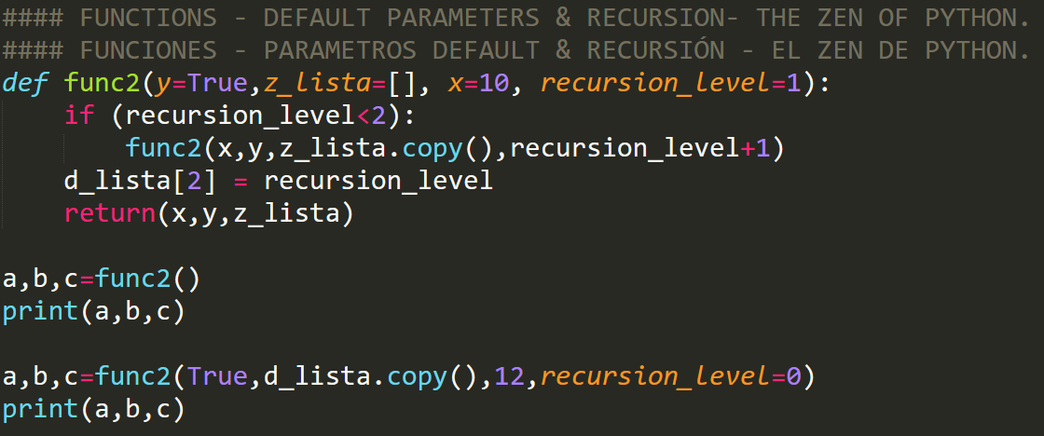
#### FUNCTIONS - DEFAULT PARAMETERS & RECURSION- THE ZEN OF PYTHON.
#### FUNCIONES - PARAMETROS DEFAULT & RECURSIÓN - EL ZEN DE PYTHON.
def func2(y=True,z_lista=[], x=10, recursion_level=1):
if (recursion_level<2):
func2(x,y,z_lista.copy(),recursion_level+1)
d_lista[2] = recursion_level
return(x,y,z_lista)
a,b,c=func2()
print(a,b,c)
a,b,c=func2(True,d_lista.copy(),12,recursion_level=0)
print(a,b,c)

Slide 43
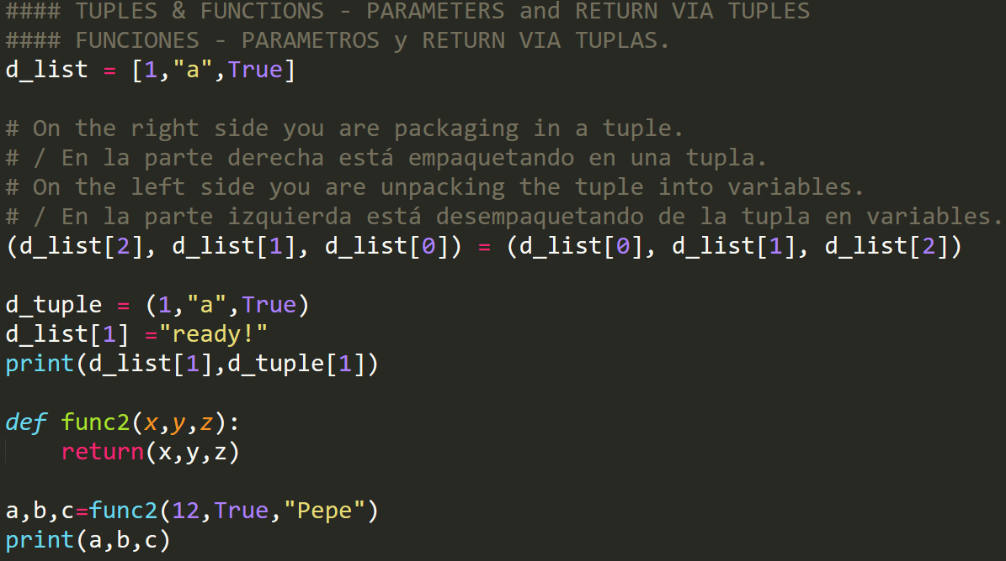
d_list = [1,"a",True]
(d_list[2], d_list[1], d_list[0]) = (d_list[0], d_list[1], d_list[2])
d_tuple = (1,"a",True)
d_list[1] ="ready!"
print(d_list[1],d_tuple[1])
def func2(x,y,z):
return(x,y,z)
a,b,c=func2(12,True,"Pepe")
print(a,b,c)

Slide 44
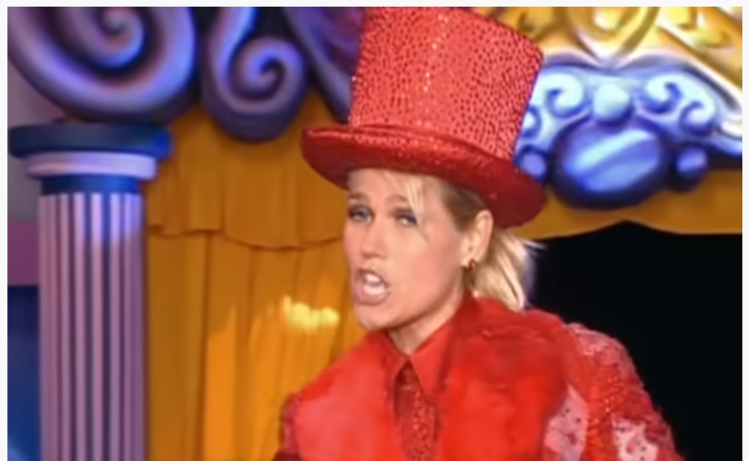
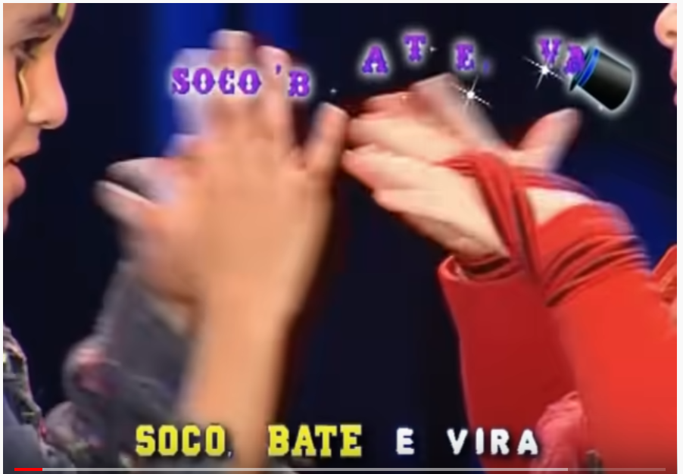
for winning an extra participation you have to send your solution for the soco_bate_vira(n) extra participation Python function challenge by email until Monday 24th of May 23:59.
Please send straight as text in the body of the email to mfalonso@faculty.ie.edu (do not include as a soco_bate_vira.py as it slows down me checking it, thanks!)
Find the pattern, then write a function: soco_bate_vira(n)
That receives:
> soco_bate_vira(2)
[1] Soco Soco Bate Bate Soco Soco Vira Vira
> soco_bate_vira(1)
[1] Soco Bate Soco Vira
> soco_bate_vira(0)
[1] Soco Bate Vira
What is the result of soco_bate_vira(3)?
soco_bate_vira(4)
soco_bate_vira(5)
soco_bate_vira(N)
soco_bate_vira(100)
https://www.youtube.com/watch?v=VZGcm_JYOKM
Chocolate prize next F2F class for anyone that can do this version in class:
https://www.youtube.com/watch?v=zk_3onMpwwU

Slide 45
MATERIAL EXTRA

Slide 46
Python

Slide 47
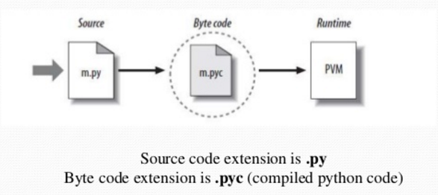
Python is interpreted

Slide 48
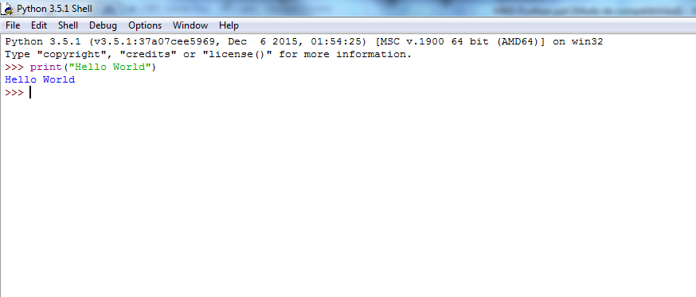
Scripting Python

Slide 49

Back to the theory…

Slide 50
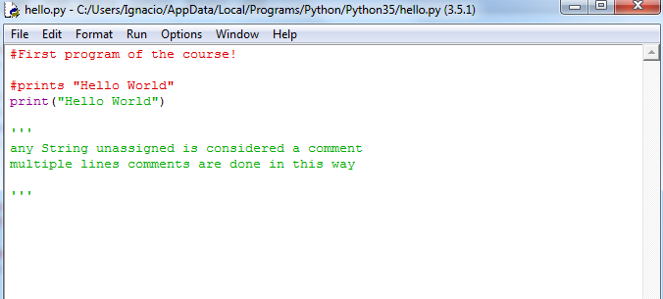
Comments in Python
# for a single line comment
‘’’…’’’ for a multiple line comment

Slide 51
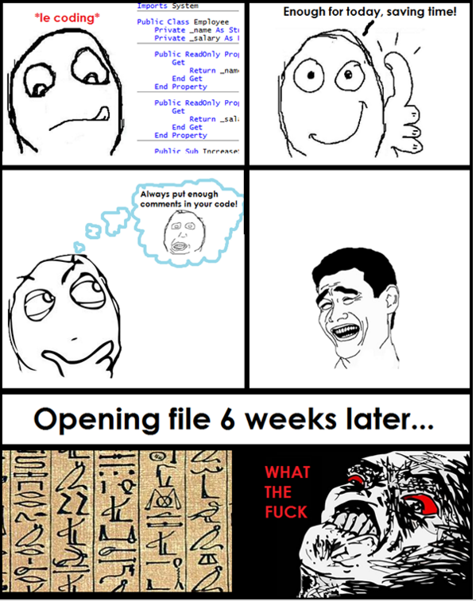
Comments in Python
Comment your code
Think what will happen when you open the source file three months after coding it…
General overview of the program/function/class
Important variables/calculations
Design considerations

Slide 52
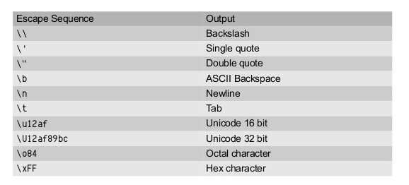
String escape sequences

Slide 53
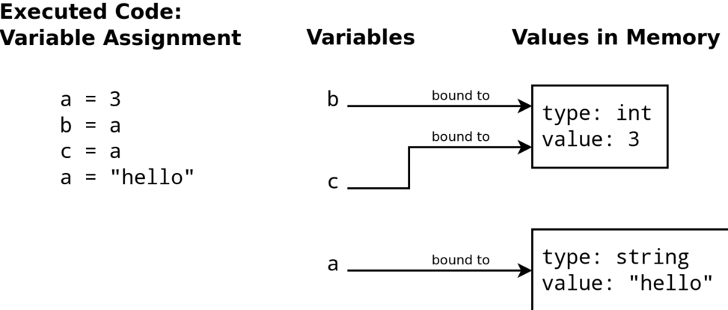
Variables in Python

Slide 54
Variables in Python
Don’t need to have a pre-defined type, they get the type from the value they are pointing at
Four main types:
String – holds text based values
name = “Ignacio”
int – Integer numbers
name = 10
float – floating decimal numbers
name = 10.4
Boolean (True or False)
More variable types (lists, tuples, dictionaries to be reviewed during the course)

Slide 55
Variables in Python
A variable has
a name (identifier)
a type
a scope
and …a value
A valid identifier is a non-empty sequence of characters with:
The start character can be the underscore "_" or a capital or lower case letter
The letters following the start character can be anything which is permitted as a start character plus the digits
Identifiers are case-sensitive!
Python keywords are not allowed as identifier names!

Slide 56
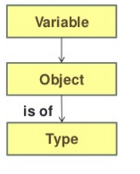
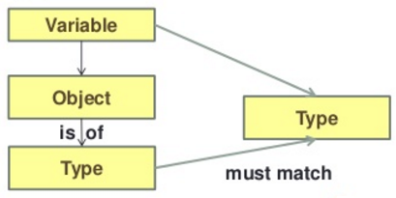
Python vs. other languages
Python
Statically typed languages
Variable type determined at runtime
Variable bound to one object and the object has only one type
Varible can change type by changing the type of the object bound to the variable
Bound to a type at compile type
Bound to an object at runtime
Need to declare the variable before using it

Slide 57
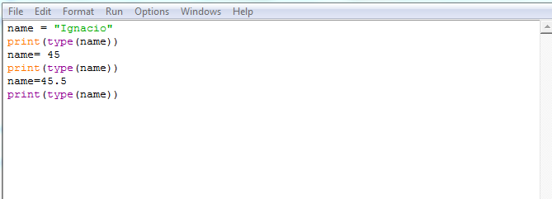
Python is a dynamically typed language

Slide 58
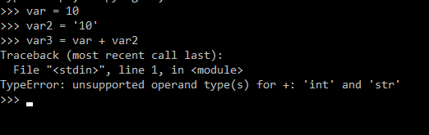
Python is a strongly typed language

Slide 59
With every great power…
Guidelines
Use descriptive names (x vs. sales_amount)
Be consistent (user_name or userName?)
Follow the traditions of the language
Usually in Python variable names start with a lowercase letter and avoid starting with an underscore
Keep the length in check
no user_total_sales_month_report

Slide 60
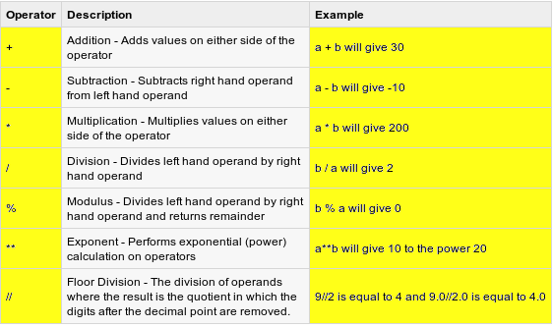
Mathematical operators
Source:http://www.emcu.it/

Slide 61
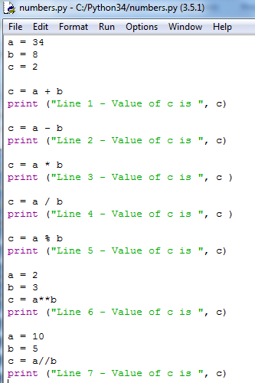
Mathematical operators

Slide 62
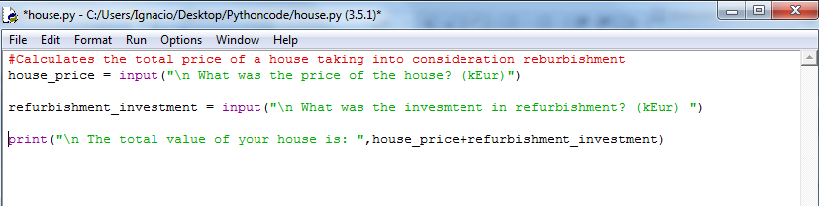
What is wrong with this program?

Slide 63
Converting values
float(x) - returns a floating-point value by converting x
int(x) - returns an integer value by converting x
str(x) - returns a string value by converting x
bool(x) – returns a boolean value

Slide 64
Data Type Conversion:
Function | Description
int(x [,base]) | Converts x to an integer. base specifies the base if x is a string.
long(x [,base] ) | Converts x to a long integer. base specifies the base if x is a string.
float(x) | Converts x to a floating-point number.
complex(real [,imag]) | Creates a complex number.
str(x) | Converts object x to a string representation.
repr(x) | Converts object x to an expression string.
eval(str) | Evaluates a string and returns an object.
tuple(s) | Converts s to a tuple.
list(s) | Converts s to a list.
set(s) | Converts s to a set.
dict(d) | Creates a dictionary. d must be a sequence of (key,value) tuples.
frozenset(s) | Converts s to a frozen set.
chr(x) | Converts an integer to a character.
unichr(x) | Converts an integer to a Unicode character.
ord(x) | Converts a single character to its integer value.
hex(x) | Converts an integer to a hexadecimal string.
oct(x) | Converts an integer to an octal string.

Slide 65
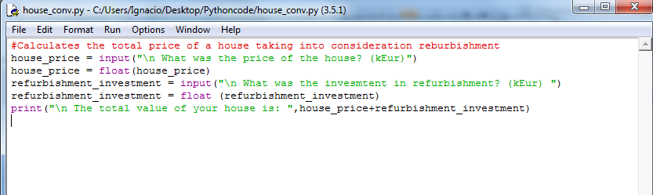
Converting values

Slide 66
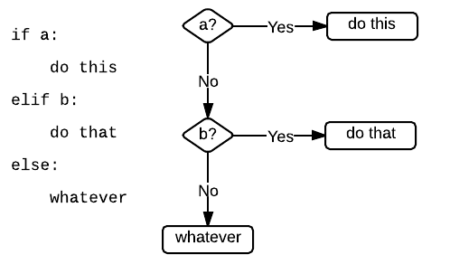
If – else - elif

Slide 67
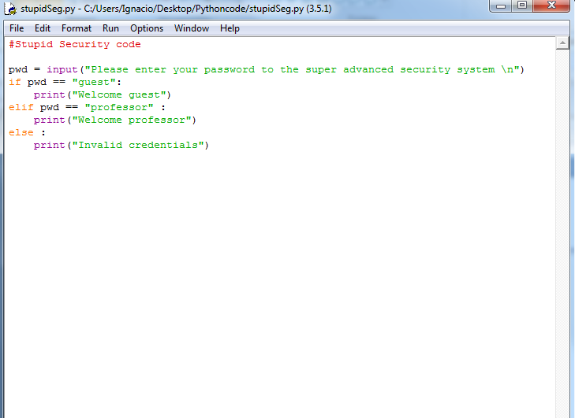
If – else - elif

Slide 68
Logical operators

Slide 69
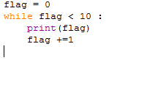
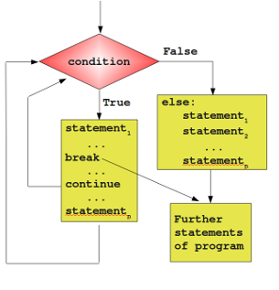
While Loop

Slide 70
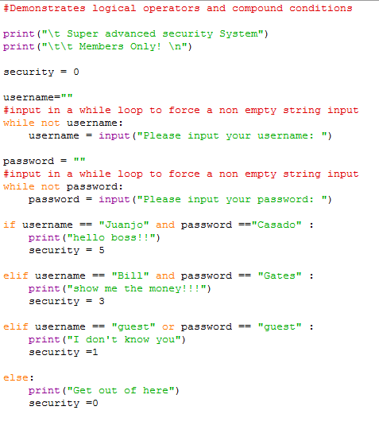
While and if

Slide 71

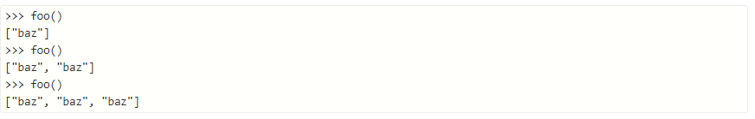

Part 2: Troubleshooting/Debugging
Misusing expressions as defaults for function arguments

Slide 72


Part 2: Troubleshooting/Debugging
Misunderstanding Python scope rules

Slide 73


Part 2: Troubleshooting/Debugging
Not Using Exceptions At All
What if “debug.log” exist, but there comes some error while removing it?

Slide 74


Part 2: Troubleshooting/Debugging
Modifying a list while iterating over it

Slide 75


Part 2: Troubleshooting/Debugging
What if I don’t know how to solve the problem:
1 - Try to interpret the error message/error logs.
2- Search the web with the error message
3 - Use an Idle (Spyder or Pycharm) Open the variable explorer to check if the values of the variables make sense.

Slide 76

Part 2: Troubleshooting/Debugging
4 - Use debugging tools: https://www.youtube.com/watch?v=Jb2HHOahvcE
5 - Try to get to the line which the code is breaking by placing prints using “clever” numbering…

Slide 77

Part 2: Troubleshooting/Debugging
6 – If the error is inside the data, we can locate the data point with error by using binary search:
http://www.geeksforgeeks.org/binary-search/

Slide 78
Part 2: Troubleshooting/Debugging
7 – Restart Python, Notebook, Spyder whatever you are using
8 – Restart the Operational System
9 – Check/Update/Downgrade Python Package
10 – Change your code to use a different Python Package, library or data type
11 – Test a different Operational System, if it work somewhere else (stay there or check versions - Check/Update/Downgrade Python Package)
12 – Start coding again, consider doing everything from scratch.

Slide 79
Part 2: Troubleshooting/Debugging
Some references: https://www.toptal.com/python/top-10-mistakes-that-python-programmers-make
http://www.techbeamers.com/python-programming-mistakes/

